Slide 1

yala Iteration II
Jake Allen, Evan Berryman, Sam Hobbs

Slide 2
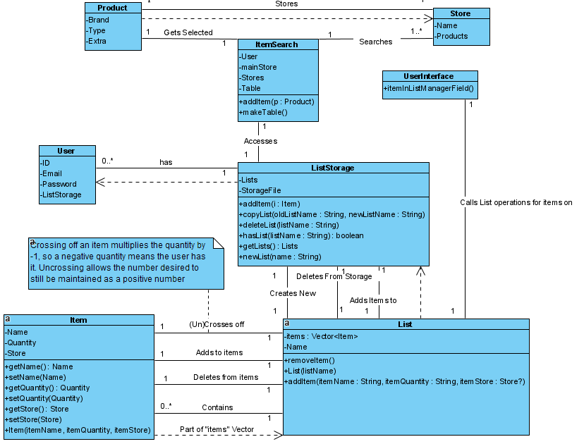

Slide 3
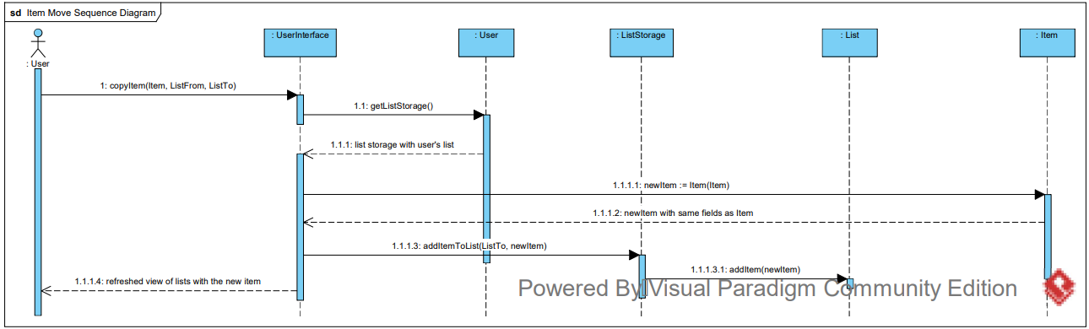
Searching for Items

Slide 4
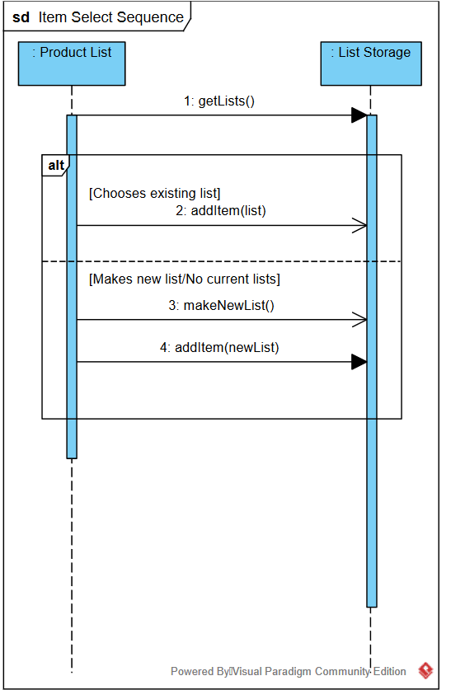
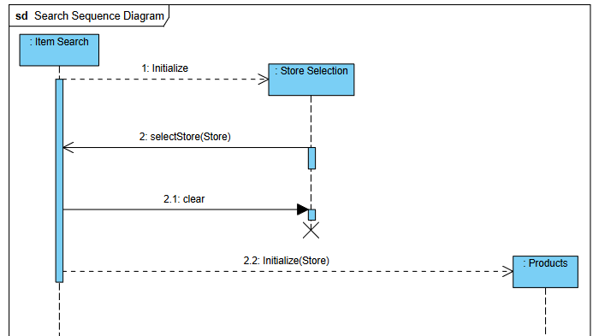

Slide 5
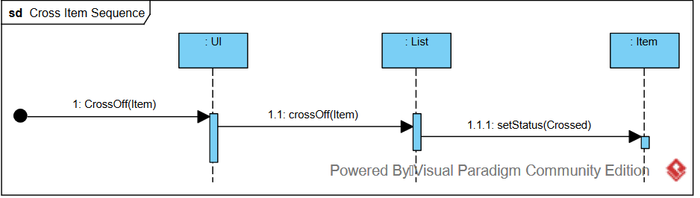
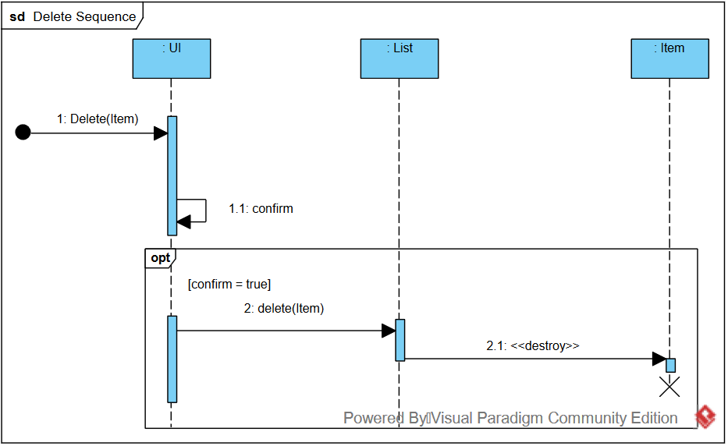
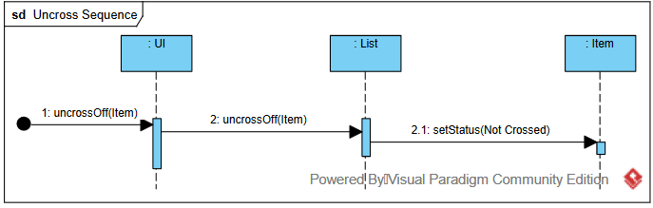
Item Management

Slide 6
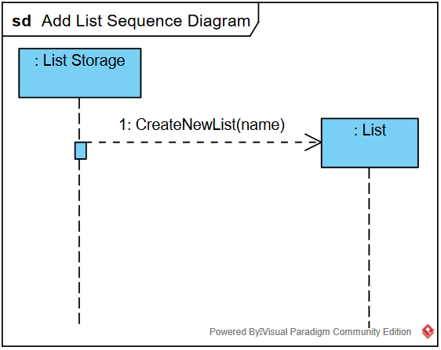
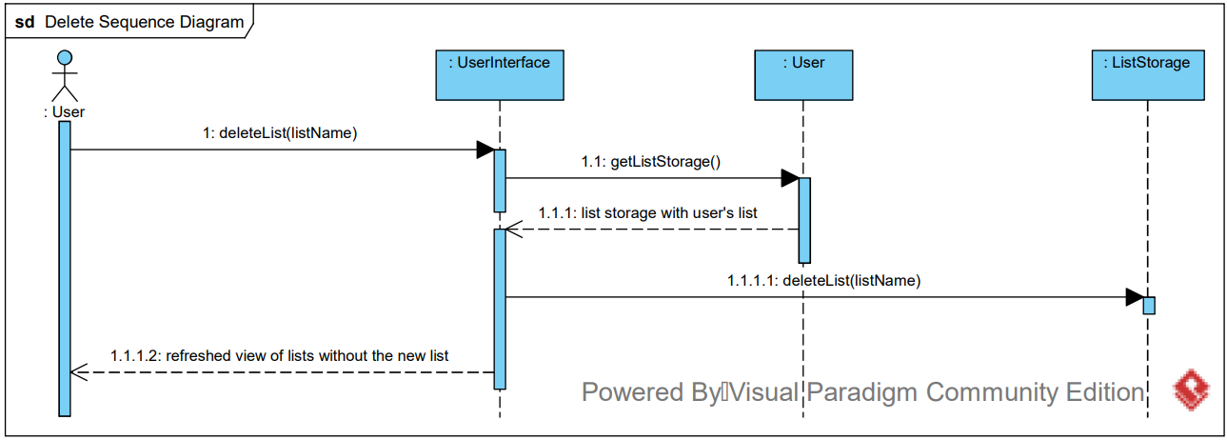
List Management

Slide 7
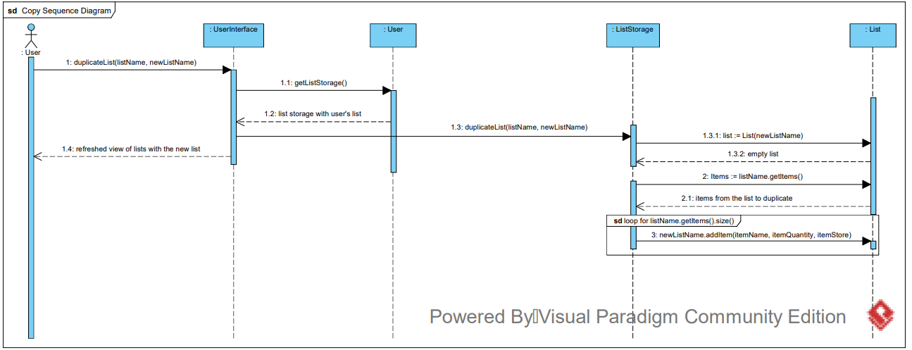

Slide 8
Test Coverage Plan
Current plan is to test the following:
Searching/Adding Items
Manipulating Items w/in a List
Manipulating user’s Lists
Saving List data for any number of users, even while program is closed
Saving data into text files – verify with Junit
System response to user input (valid text inputs, searching/creating accounts, etc.)

Slide 9
Future Priorities
Encrypting necessary data and developing a database and database methods to increase the efficiency and safety of our storage
Improving the design and formatting of the user interface for a more attractive and friendly appearance for the user
Employing methods for stores and inventories to be easily added so that users can have more stores to search and more items to find
Finishing our integration and test planning
Creating documentation for the user
Moving into our Transition phase and preparing for our Iteration III Presentation and deployment

Slide 10
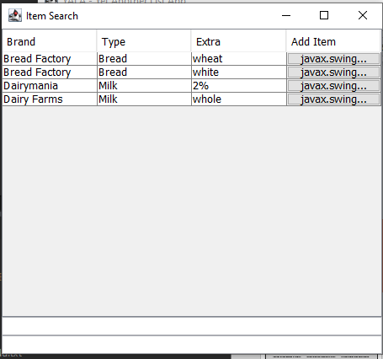

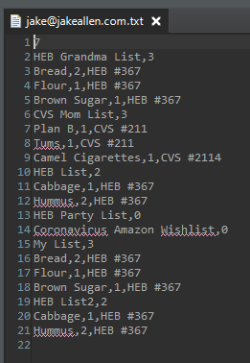
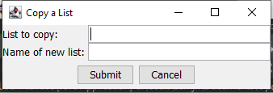



Slide 11
Links
Project Hosting: https://github.com/jake-allen/YALA
Timecard tracking: https://trello.com/b/8JTgqSMS/yala

Slide 12
Questions? Concerns?

